Slide 1
NewsVision: OCR Error Correction Tool for Chinese Newspapers
Final Year Project, EE4080
Gan Wei Jie, EEE Y4

Slide 2
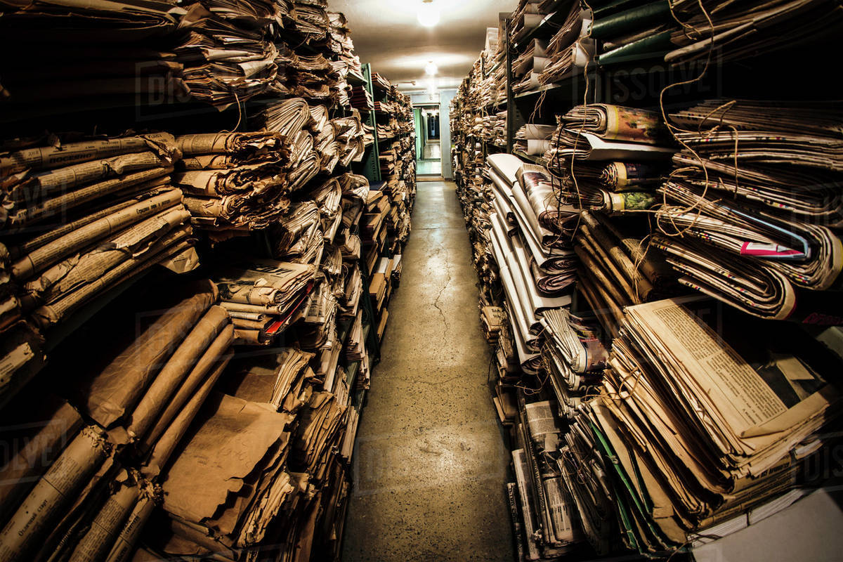
Newspaper Digitisation
90% of newspapers remained undigitized.
(CRL, 2015)

Slide 3

Newspaper Digitisation
Easy to Search
Easy to Access
Easy to Store & Back up
Notes:
Benefits are numerous
Easy to search, easy to store, easy to back up

Slide 4
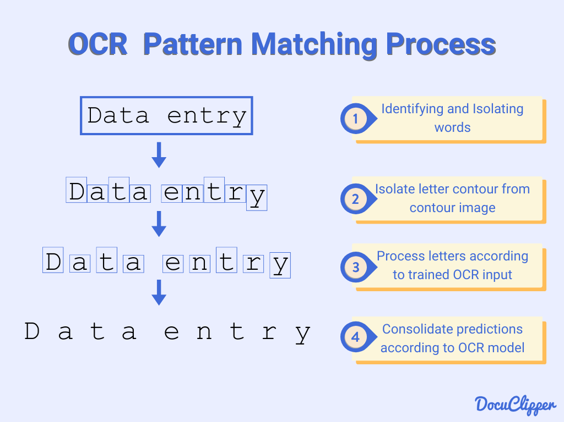
Optical Character Recognition (OCR)
Notes:
In order to convert images into machine editable text, we have to make use of an Optical Character Recognition software, or OCR for short.
These software works by analysing visual patterns in images to detect text.
However, these software tends to scan from left to right and this creates a problem with newspaper clippings.

Slide 5
Problem: Disorganized Text
Title
Line 1
Line 4
(Text from Image)
Line 2
Line 5
Caption
Line 3
Line 6
Line 8
Title
Line 1 Line 4
Line 2 Line 5 Caption
Line 3 Line 6 Line 8
Image
(with Text)
OCR
Original Newspaper Clipping
OCR-ed Text
Notes:
Newspaper clippings are highly unstructured, with text having multiple columns and wrapping around images.
An ordinary OCR would produce a disorganised output as shown in the slide.

Slide 6
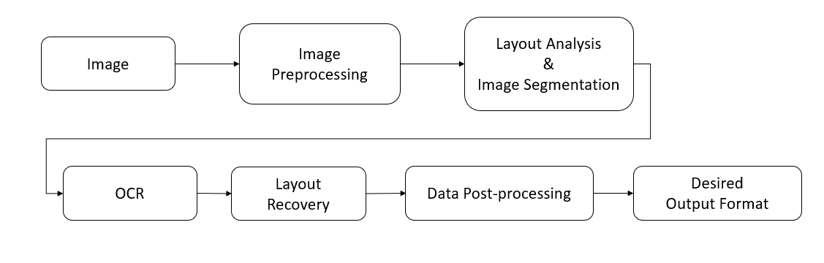
Objective
Tool to convert Newspaper Clippings Images into Machine-Editable Text
Notes:
Therefore, the objective of the project is simple, to create a system that is able to OCR these newspaper clippings without mixing up the sentences.

Slide 7


Scope
Layout parser module
Chinese SG Newspapers (LianHeZaoBao, ShinMin Daily)
Input: .png, .jpeg
Output: .txt
Notes:
The scope of the project is to develop a layout parser module that will complement the OCR engine in detecting the layout of the text.
Additionally, the project will be trained on local Chinese newspapers.

Slide 8
Chapters
NewsVision System
Model Training
Implementation
Pipeline
Data Preparation
Training Process
Notes:
I will split the project into 2 chapters, the first is to explain the newsvision pipeline, and the second will describe my training process for the layout parser module.

Slide 9

NewsVision System
Notes:
So I will begin with the newsvision system

Slide 10

Implementation
PaddleX development toolkit by PaddlePaddle (Baidu's open-source AI platform)
PaddleOCR
PaddleDetection
Notes:
The system is developed using the paddle development toolkit. I’ve made use of the paddle ocr for the ocr engine and the paddle detection framework for the layout parser module.

Slide 11
NewsVision Pipeline
Modular Design
Local / Offline
PaddleDetection
PaddleOCR
Notes:
The newsvision system follows a modular design and works entirely offline so that it is highly customisable to the user’s needs.
The core of the system have 3 main components, the layout parser module, the ocr engine and the layout recovery stage.
We start by feeding the image to the layout parser module to break up the image into segments for the ocr to scan individually.
The ocr engine, will then process each image and tag the output to each segment.
Finally, the layout recovery module will piece together the segments like a jigsaw puzzle.
The final output can then be converted to whatever format the user decides.
I will go through each of the core components in detail.

Slide 12
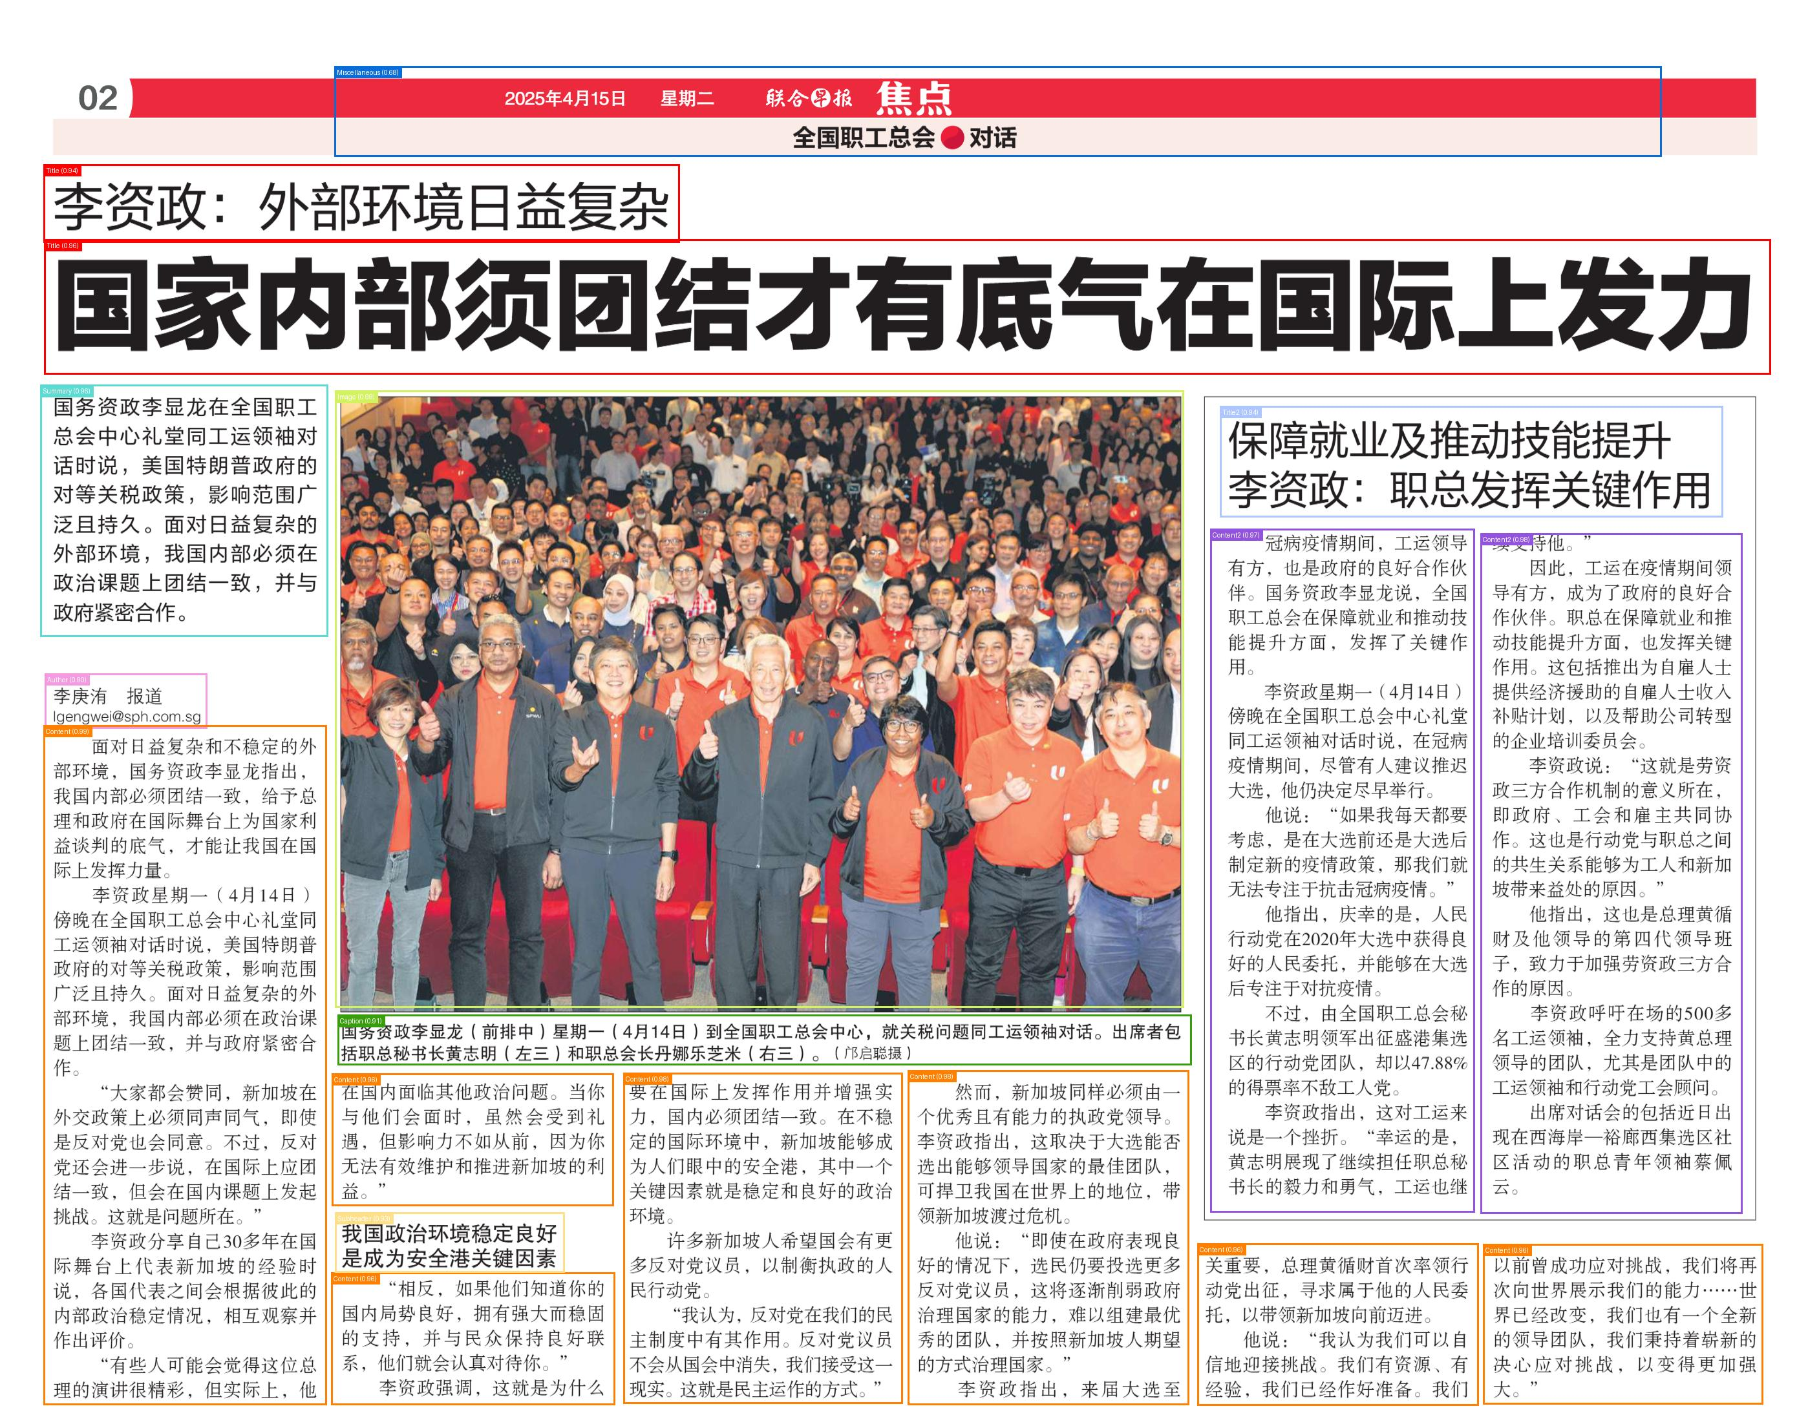
Layout Analysis & Image Segmentation
10 Classes:
Headline,
Author,
Sub-header,
Content Blocks,
Image,
Caption,
Pre-Content,
Secondary Title
Secondary Content
Miscellaneous
Notes:
In the layout analysis stage,
I have trained the model to identify 10 common classes as you can see from the slides.
The secondary title and content is crucial as it is needed to prevent the text from joining up with the main content.

Slide 13
OCR Engine
Compared between Tesseract OCR, Easy OCR and Paddle OCR
Selected Paddle OCR for its Benefits:
Best Accuracy for Chinese language
Able to detect Chinese Punctuations
Doesn’t print indentations
Easy compatibility with PaddleX development suite
Notes:
We move on to the next module, which is the ocr engine.
I’ve compared between 3 popular OCR and chose paddle OCR for its high accuracy for Chinese language and also its compatibility with the paddle development suite.
However, the OCR can be easily replaced if the user wants to use their preferred version.

Slide 14
Layout Recovery Problem
How to get Reading Order (1,2,3,4)?
1
3
2
4
2, 1, 4, 3
Notes:
After scanning the image, we now have to piece together the output.
However, we are faced with a unique problem, how are we able to piece together in a reading order?
Here I have a simple diagram to illustrate the problem.
If we were to sort by left to right using the boxes centre coordinates, we get the 2,1,4,3 order.
Sorting from top to bottom would yield similar results

Slide 15
Layout Recovery Solution
Group boxes within the same column
Centre lands within Group Boundaries
Add Box into Group
Update Group Boundaries
Sort Boxes by Verticality (Y-axis) within groups
Sort Groups by Horizontality (X-Axis)
1
2
Notes:
Instead the solution is to break up the sorting process.
First I group up each boxes within the same column using a simple criteria
If the box centre lies within a group’s boundaries, it will be considered the same column.
After grouping up the boxes, we can then sort boxes vertically within their groups, and sort the groups horizontally.
The final output will result in the correct reading order.

Slide 16
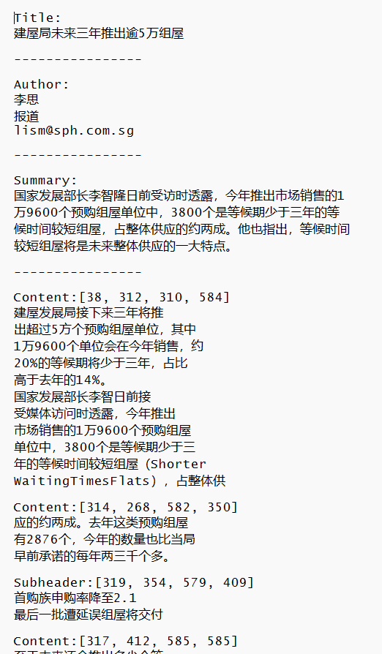
Post-Processing & Output
Can be .txt file, word doc, csv or any other formats.
Adjust based on user’s requirements.
Notes:
Finally we move to the post processing stage where the ouput can be adjusted to the user’s requirements.
In my project I simple just print the class label with the associated content into a text file.

Slide 17
Model Training
Notes:
Now we move on to training the layout parser model.

Slide 18
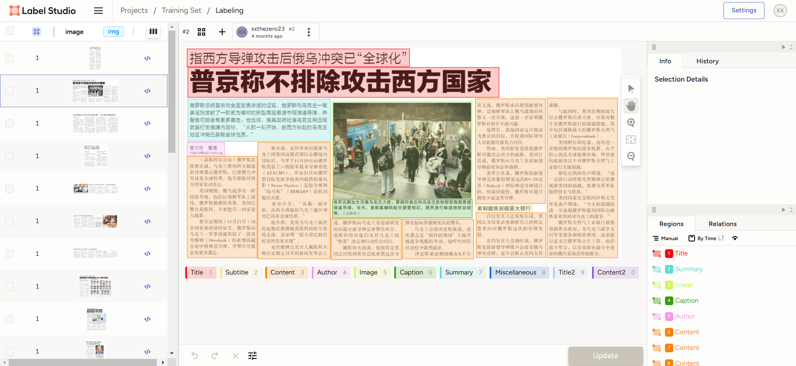
Layout Parser Training (Preparation)
Manually prepared over 900 news clippings from Shin Min Daily and LianHeZaoBao
Labelled the images using Label Studio
Saved in COCO (Common Objects in Context) Format
Notes:
To train the model, I first have to prepare the dataset. I’ve manually cropped and labelled over 900 images from shinmin daily and lianhe zaobao.
The labelled data is then saved in COCO format which is a common format in computer vision.

Slide 19
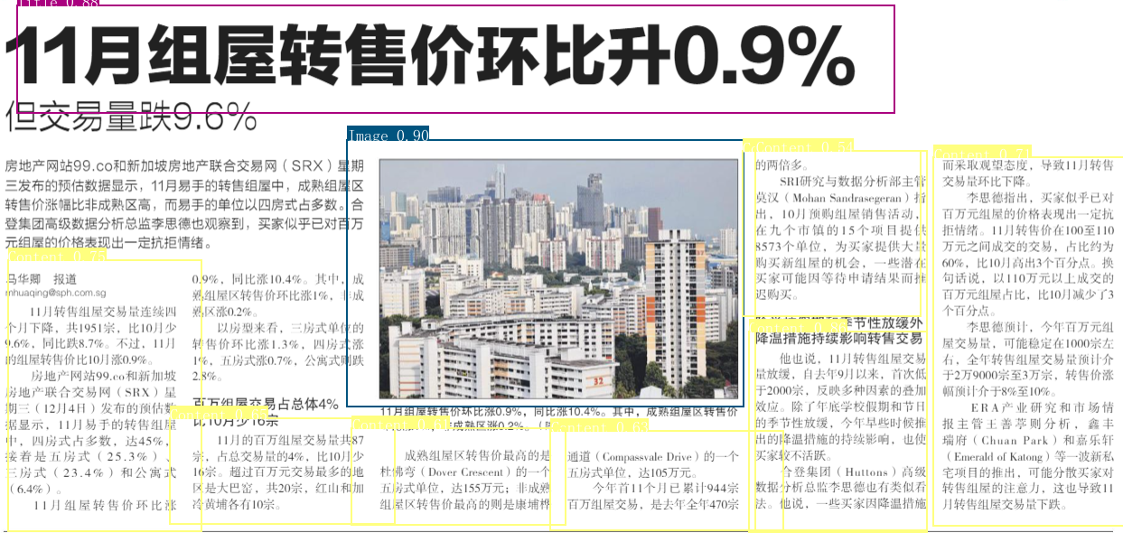
Layout Parser Training (PaddleDetection)
Used “picodet_lcnet_cdla_layout” Pre-Trained model
Trained on Chinese Document Layout Analysis (CDLA) dataset with 10 labels
Notes:
For the training, I used a pretrained model that was trained on the Chinese document layout analysis dataset.
Here is the before training result

Slide 20
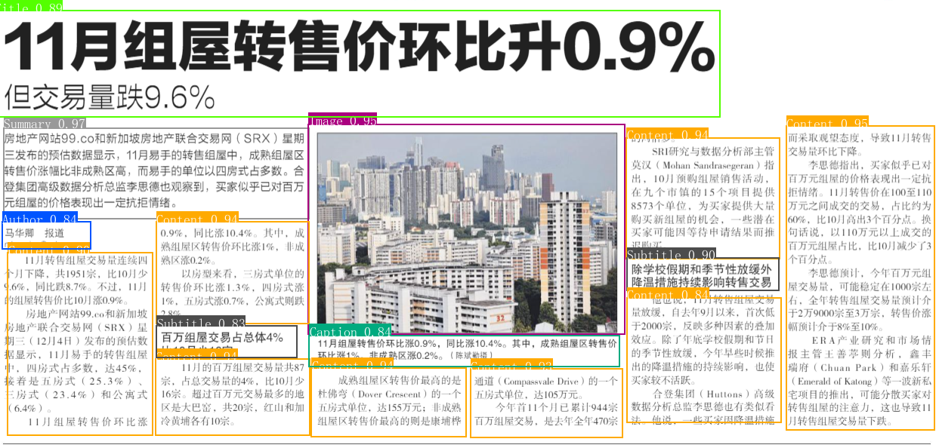
Layout Parser Training (PaddleDetection)
Used “picodet_lcnet_cdla_layout” Pre-Trained model
Trained on Chinese Document Layout Analysis (CDLA) dataset with 10 labels
Notes:
And here is the after training result.

Slide 21

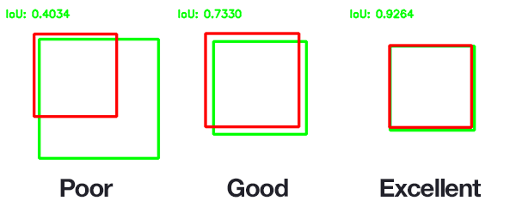
Measuring Results
Intersection over Union (IoU) > Threshold → True Positive (TP)
Intersection over Union (IoU) < Threshold → False Positive (FP)
Missed Detection → False Negative (FN)
Notes:
Before we move on to analysing the performance of the layout parser module, we first have to understand how the results are measured.
We first measure the IoU of the prediction and the actual labelled data. This is the area of overlap divided by the area of union.
A high iou means it’s a good prediction as it closely resembles the actual labelled data.
We can set a threshold for our desired performance, if the iou is above the threshold and the class is predicted is correct, then it’s a true positive outcome.
If the iou is below the threshold or the label is incorrect, then it’s a false positive.
If the model didn’t identify the object at all, we consider it as a false negative.

Slide 22
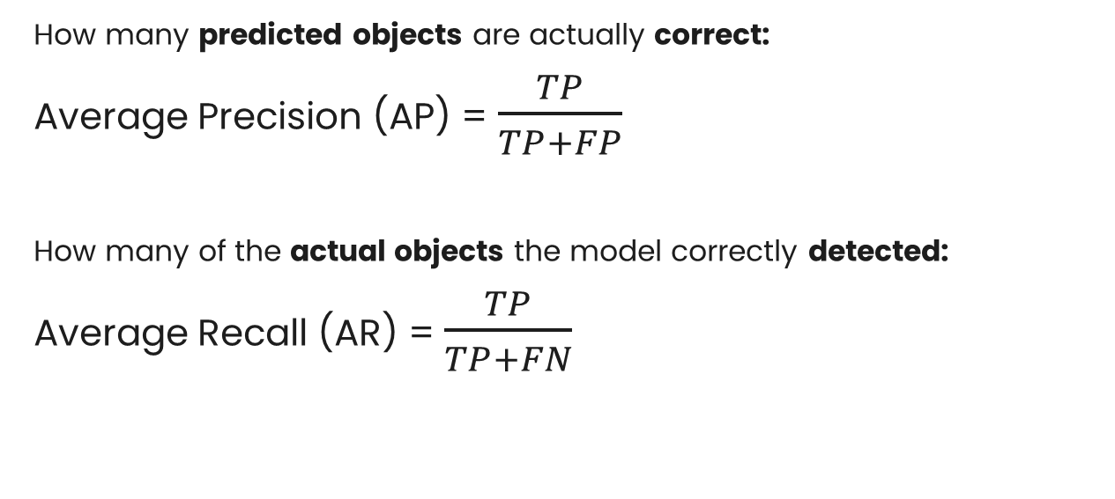
Measuring Results
How many predicted objects are actually correct:
Average Precision (AP) = $\frac{TP}{TP+FP}$
How many of the actual objects the model correctly detected:
Average Recall (AR) = $\frac{TP}{TP+FN}$
Notes:
Therefore, the precision of the model is the true positive over all the positive detections
And the average recall is the true positive over the sum of true positive and false negative.

Slide 23
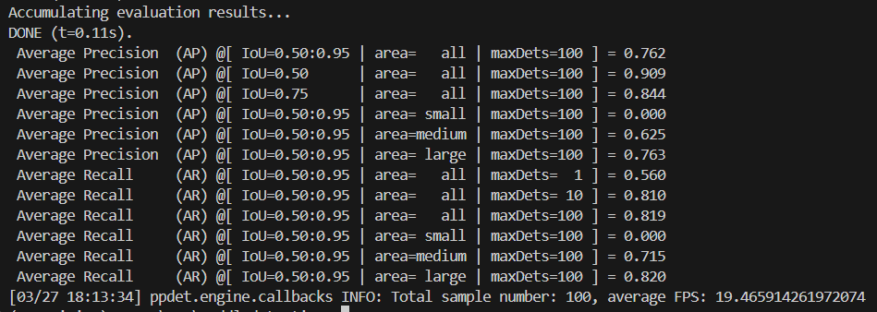
Results
Overall accuracy (AP): 76.2%
Object detection rate (AR): 81.9%
Notes:
In my best performing model, I’ve achieved an average of 76.2% in precision and an object detection rate of 81.9%

Slide 24
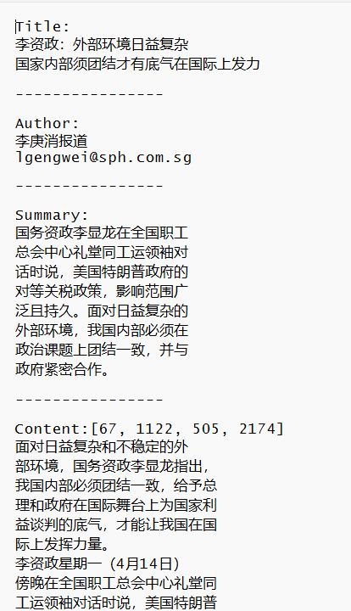
Limitations
Indentations are lost
Due to bounding box segmentation process
Can possibly be fixed with Natural Language Processing (NLP) through the use of Large-Language Models (LLM) such as ChatGPT.
Notes:
While the project is generally a success, it has its limitations.
Mainly, the indentations are lost in the final output as a result of the bounding box segmentation process
However, this can possibly be fixed using NLP models.

Slide 25
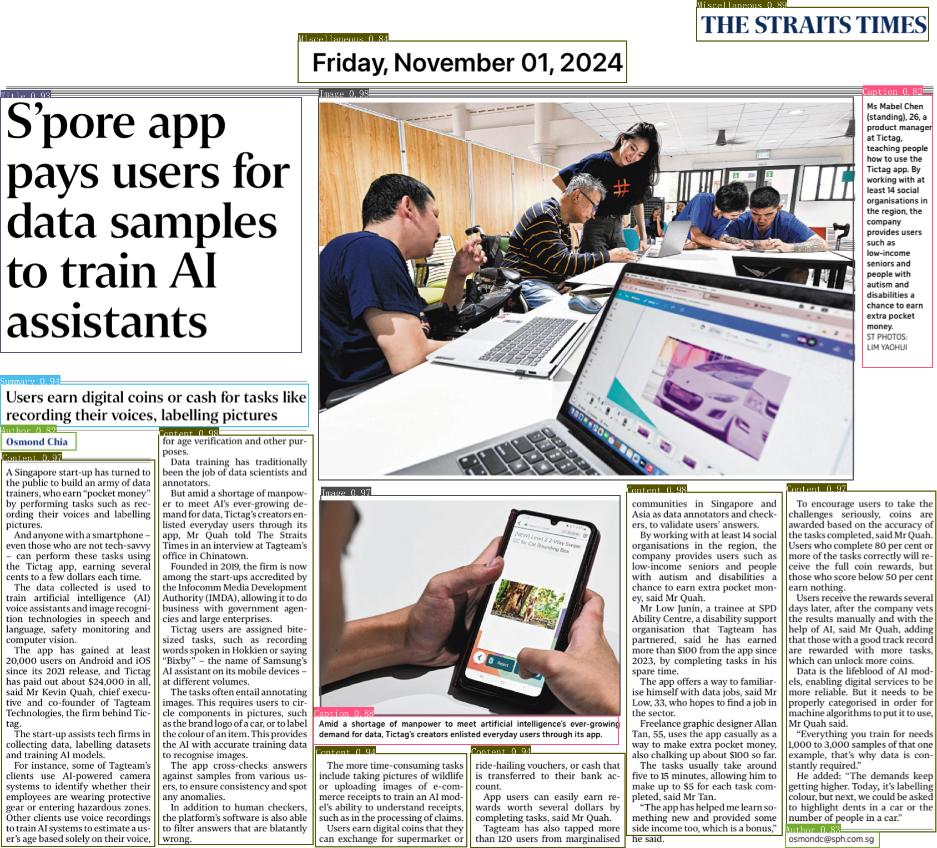
Future Improvements
Multi-Lingual Support – Train on other languages, such as English.
Newspaper Segmentation – Process entire newspaper page instead of just clippings
Notes:
For future improvements for the project, firstly the system can be further developed for multi-lingual support.
Secondly, The system can be further developed to include the newspaper segmentation. This can help improve the ease of use by allowing the user to feed it an entire newspaper page in 1 go instead of manually segmenting into newspaper clippings first.

Slide 26
Conclusion & Significance
NewsVision works as a Standalone OCR Tool
Minimize Manual Labour
Serves as a base for future OCR tools
Notes:
In conclusion, Newsvision works as a standalone tool and it aims to help minimise manual labour in the ocr process.
This project also serves to act as a base for future ocr systems.

Slide 27
Thanks!
Do you have any questions?
Please keep this slide for attribution

Slide 28
References
CRL. (2015). The “State of the Art”: A Comparative Analysis of Newspaper Digitization to Date. https://www.crl.edu/sites/default/files/d6/attachments/events/ICON_Report-State_of_Digitization_final.pdf
J. Martinez, “What is OCR and how does OCR work? - DocuClipper,” DocuClipper. Jul. 22, 2024. [Online]. Available: https://www.docuclipper.com/blog/ocr/
Devlin, J., Chang, M., Lee, K., & Toutanova, K. (2019). BERT: Pre-training of Deep Bidirectional Transformers for Language Understanding. Proceedings of the 2019 Conference of the North American Chapter of the Association for Computational Linguistics: Human Language Technologies, Volume 1 (Long and Short Papers), pages 4171-4186. https://doi.org/10.18653/v1/n19-1423
Guillaume Chiron, Antoine Doucet, Mickaël Coustaty, and Jean-Philippe Moreux. 2017. ICDAR 2017 competition on post-OCR text correction. In 2017 14th IAPR International Conference on Document Analysis and Recognition (ICDAR), volume 1, pages 1423–1428. IEEE.
Kumar, A., Makhija, P., & Gupta, A. (2020). Noisy text data: Achilles’ Heel of BERT. In Proceedings of the Sixth Workshop on Noisy User-generated Text (W-NUT 2020), pages 16-21. https://doi.org/10.18653/v1/2020.wnut-1.3
Radford, A., Wu, J., Child, R., Luan, D., Amodei, D., & Sutskever, I. (2019). Language models are unsupervised multitask learners. OpenAI blog, 1(8), 9.
Soper, E., University at Buffalo, SUNY, Fujimoto, S., Ancestry.com, Yu, Y.-Y., & Work Done at Ancestry.com. (2021). BART for Post-Correction of OCR Newspaper Text. In Proceedings of the 2021 EMNLP Workshop W-NUT: The Seventh Workshop on Noisy User-generated Text (pp. 284–290). Association for Computational Linguistics. https://aclanthology.org/2021.wnut-1.31.pdf
Tanner, S., Muñoz, T., & Ros, P. H. (2009). Measuring mass text digitization quality and Usefulness: Lessons learned from assessing the OCR accuracy of the British Library’s 19th Century Online Newspaper Archive. http://www.dlib.org/dlib/july09/munoz/07munoz.html

